Slide 1
Geothermal Energy
“Energy for the future, But the Future
is now”
Elaine Egan
Dr. Rory Dunphy GSI
Dr. Koen Verbruggen GSI

Slide 2
Outline of Module: Lesson 1: Introduction to Geothermal Energy (Case study: Iceland) (Double or Part1/Part2) Lesson 2: Geothermal Energy Capture Types & Case Study: Ireland Lesson 3: Student Investigation Question: What type of Geothermal Energy Capture is most suitable for Dublin City & Why? Lesson 4: Group Presentation of Research Findings/Assessment

Slide 3
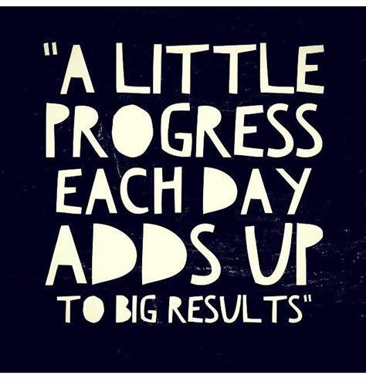
Module Learning Outcomes:
Students should be able to understand the concept of geothermal energy and its link to rocks
Gain a deeper understanding into the geological processes involved in geothermal energy
Learn about the ways in which geothermal energy is captured and its uses
Learn about a number of case studies; Iceland & Ireland
Work together to investigate if geothermal energy is/can be a source of sustainable renewable energy for areas in Ireland and identify advantages and/or current limitations.

Slide 4
Lesson 1 outline:
Geothermal Energy Introduction & Iceland Case Study
Think/ Pair/ Share- Brainstorm on the links that volcanic activity and the rock cycle have on geothermal energy
Advantages/Limitations of Geothermal Energy displayed by students on classroom wall
Video on Geothermal Energy in Iceland
Advantages/ Limitations on wall revisited and added to
General video on Geothermal Energy & exit card activity
LC Case study on Geothermal Energy in Iceland (Read & use Placemat to break down content)

Slide 5
Geothermal Energy: Volcanic Activity & Rock Cycle
Class Activity 1 (5 mins):
Look at the Fig 1. The Rock Cycle:
Think about the links that volcanic activity and the rock cycle has with Geothermal Energy
Pair with your neighbor and discuss (add to your points if possible)
Share and input into to a brainstorm on the whiteboard
Fig. 1 The Rock Cycle
Class Activity 2: (5 mins)
Take a sticky note and write any advantages/ limitations of geothermal energy you can think of, and stick it to the GEOTHERMAL WALL!!

Slide 6
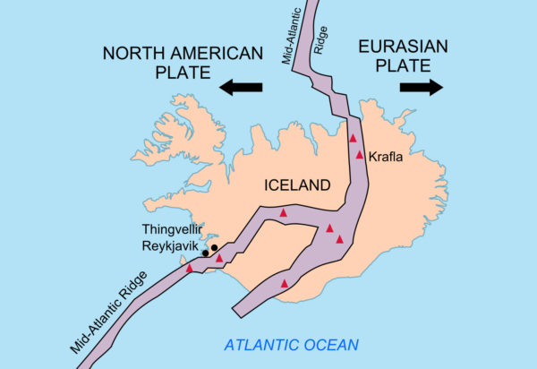
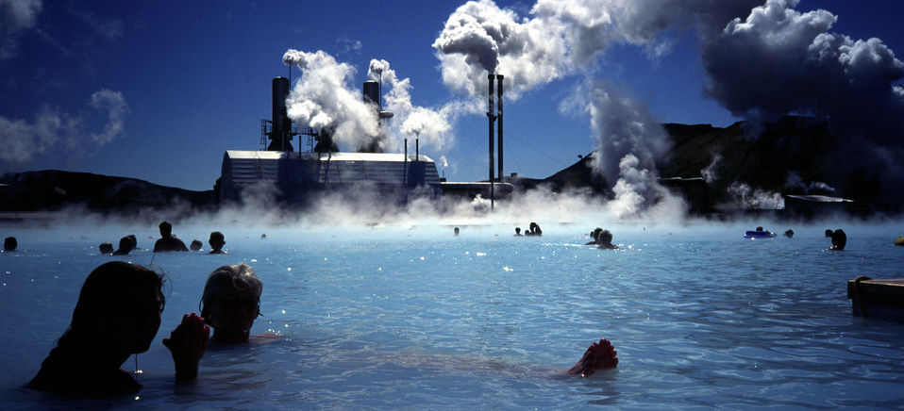
Geothermal Energy: Iceland
Fig. 2 Located North of Ireland on the boundary of the N. American & Eurasian constructive plates
Fig. 3 Geothermal Power plant and Blue Lagoon
Class Activity 3
While watching the following video, note any further advantages/ limitations that you learn about and place them on a sticky note to add to the wall afterwards
How Geothermal Energy Revolutionised Iceland’s Greenhouses | Earth Lab - YouTube (9 mins)

Slide 7
Homework Task:
End of Class Activity:
Watch the following: (3mins)
Energy 101: Geothermal Energy – YouTube
Fill in the exit card & leave on your desk:
Read handout on Geothermal Energy in Iceland
Using Placemat template break down the case study into bullet point facts using the 4 headings:
1. Iceland and Geothermal Energy
2. How is geothermal energy captured?
3. Uses of Geothermal energy
4. Benefits of Geothermal Energy

Slide 8
Lesson 2 Outline: Part 1: Geothermal Energy Capture Types & Case Study: Ireland
Handout on Geothermal Energy Explained (Dr. Sarah Blake GSI)
Various students read out each section and then discuss main points for further clarification.
Geothermal Energy in Ireland FAQ (students spend time reading this, noting important facts- highlight to them that this is very useful information that they may wish to use when given the main module task)
Use of the Geothermal Suitability maps for Ireland
Homework Activity: Identifying areas of suitability for each of the 3 types (vertical closed loop, open loop domestic and open loop commercial)

Slide 9
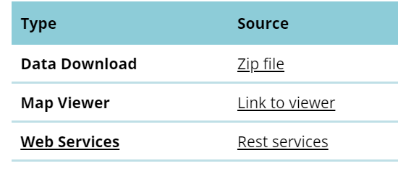
Ireland: Shallow Geothermal Energy
Activity 1: (10mins)
Handout on Geothermal Energy Explained (Dr. Sarah Blake GSI) Various students read out each section and then discuss main points
Individual Device/Handout Activity 2 (10 mins):
Geothermal_energy_FAQ.pdf (gsi.ie) Students read themselves- highlighting important facts
Group Work/Device Activity 3 (10 mins):
-Explore in groups with a device/tablet the following link: Geoenergy (gsi.ie) completing the following questions:
1. What is ground source heat energy and how can it be collected?
2. What does the Geothermal Suitability Map indicate?
3. What are the types of Geothermal Energy capture mentioned?
Group Work Activity 4 (10 mins):
When finished the questions, on the link page: Click “Link to Viewer”

Slide 10
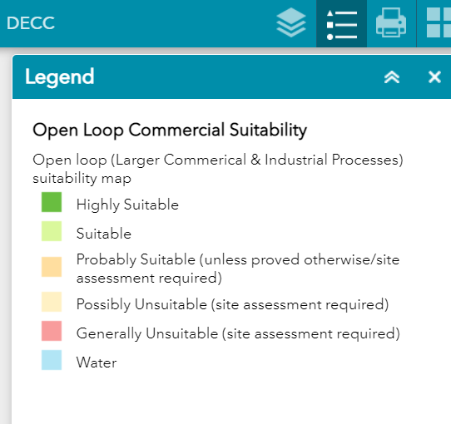
Using the Geothermal Suitability Map
An Eircode/ placename can be input to see how suitable your area is
Toggle to legend to see the suitability of areas
Click on and off the above boxes to compare the different types of geothermal energy extraction while zooming in to the map

Slide 11
Geothermal Suitability Map
Device Homework Activity: Access the map from the link given on the online platform (using information on this PowerPoint also accessed on the online platform)
Use the map on a device to identify 3 areas for each of the 3 layers (vertical closed loop, open loop domestic and open loop commercial) :
1. High Suitability
2. Probably Suitable
3. Generally Unsuitable

Slide 12
Lesson 2 Outline: Part 2: Geothermal Energy Capture Types & Case Study: Ireland
5 min video on use of the Irish District Heat Atlas Map
Students use devices in groups to experience the data available on Irish District Heat Atlas Map
Investigation of the Tallaght District Heating Scheme and Questions to answer
Homework Activity to investigate further information available through links provided

Slide 13
Using The Irish Heat Atlas Map: Irish District Heating Association
Class Activity 1 (5 mins):
Irish Heat Atlas: Version 1 – YouTube Please watch this 5 min video on how to use the map and gain insight into the potential for district heating uses in different areas of Ireland (in specific please focus on Dublin)
Groupwork/Device Activity 2 (15 mins):
Click the link now and familiarise yourself with the map: Irish Heat Atlas Version 2.1 (arcgis.com) (Look at all areas, but also a focus on Dublin)

Slide 14
District Heating Projects in Ireland: Tallaght
Tallaght District Heating Scheme | Energy Efficiency Agency Dublin | Codema
Group/Device Activity 3 (15 mins): Click on the link and answer the following questions:
1. When is the projects Phase 1 due to start?
2. How many tonnes of CO2 does the project aim to reduce each year?
3. What is district heating?
4. Where will the waste heat be obtained from and how much of the energy demand will it cover?
5. How much funding was secured for the project and where did it come from?
6. List 4 benefits of being connected to a District Heating Scheme

Slide 15
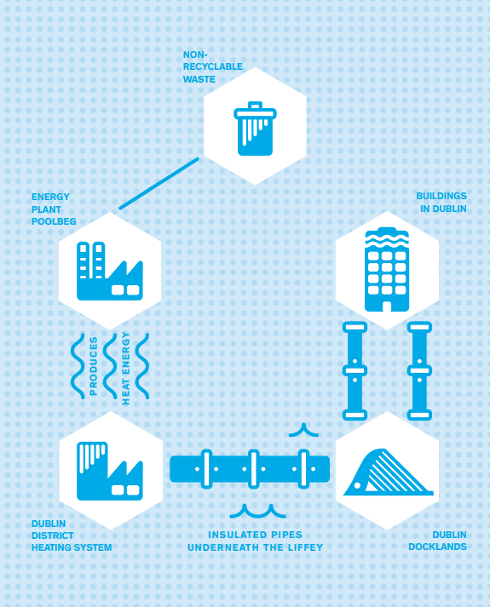
How it works..
More Information: district_heating_brochure.pdf (codema.ie)
Fig 1. Waste incinerated in Poolbeg produces heat energy that is put through the DHS and piped under the liffey to Dublin docklands and buildings in Dublin
Fig. 2 Insulated pipes (left) and new service tunnel under the Liffey (right)

Slide 16
Further Information Links
Homework Device Activity: Please click on the links below and investigate the further information that is available for your final task
Geothermal Energy (gsi.ie)
Energy 101: Geothermal Heat Pumps – YouTube
Geothermal Energy | A Student's Guide to Global Climate Change | US EPA
Shallow Geothermal Energy (gsi.ie)
district_heating_brochure.pdf (codema.ie)

Slide 17
Lesson 3 outline: Student Investigation into Geothermal Energy viability in Dublin City
Arrange students into groups of approx. 4 students each
Direct students to school platform (or online classroom) where they can access links/resources used in the module and/or additional resources to assist their research.
Outline research question and break down the body of the research
Outline methods of producing/submitting findings (video, powerpoint presentation, report)
Students may be given an extra class to work on this if needed.

Slide 18
Student Investigation into Geothermal Energy viability in Dublin City
Group 1 | Group 2 | Group 3 | Group 4 | Group 5 | Group 6
Investigating : What type of geothermal energy is suitable for Dublin city and why?

Slide 19
Breakdown of Research Question:
Research Question: What type of geothermal energy is suitable for Dublin city and why?
In groups do an approx. 5-10min presentation/report/video on what type of geothermal energy capture is most suitable for Dublin city and why.
Think about:
What type is most suitable:
Geologically
Economically
Demand
Limitations/ Current Barriers
➔ Each person will take on an area to research
➔Resources online on student accessed platform (provided)

Slide 20
Further Instructions for this lesson:
Get into your assigned groups
Decide who is doing which role (or pick randomly)
Brainstorm/ break down the question in general as a group
Access the PowerPoint presentation/documents/links available for information to assist your research
Discuss what way/ how you are going to collaborate/ research/ targets
What presentation method will you use/ why
Questions you need to ask teacher

Slide 21
Lesson 4 outline: Group Presentation of Findings
Groups will be expected to upload their collaborated findings (to student accessed platform) as part of a finished project to asses the research question
This format can be video/PowerPoint presentation/report (5-10 mins per group depending on number of groups in the class)
Students will present their findings as a group and the remaining students should be given an opportunity to ask questions at the end of the groups time.
For assessment each group should have addressed the research question through the different aspects given (Geologically, Economically, Demand, Limitations/ Current Barriers)
Any suitable presentation formats should then be printed & displayed on the “Geothermal Wall” established at the start of the module

Slide 22
Example of Assessment
-Can be altered to suit different groups
Percentage | Descriptor | Criteria achieved based on group work and presentation of findings
90-100 | Distinction | Excellent group work, work load shared appropriately, evidence of further research, all points covered, findings identified and excellent presentation of findings
75-90 | Higher Merit | Very good group work, workload shared, some further research evident, most points covered, findings identified and very good presentation of findings
55-75 | Merit | Good group work, medium sharing of workload, little further research evident, points covered in small detail, basic findings identified,
40-55 | Achieved | Disjointed group work, poor sharing of workload, no further research evident, points not adequately addressed in a basic way, no findings identified, poor presentation of findings in general
20-40 | Partially achieved | Little to no group work, Group not collaborating in a basic manner, 1 or 2 students in group attempted work, very poor findings evident, very poor presentation of findings
0-20 | Not Graded | No group work, no roles/work shared, very little progress made, incomplete/no presentation of findings

Slide 23
Acknowledgments
Geological Survey of Ireland (GSI)
Irish Centre for Research in Applied Geosciences (iCRAG)
Dr. Rory Dunphy (GSI) (Support Researcher)
Dr. Koen Verbruggen (GSI) (Support Researcher)
Elspeth Sinclair (iCRAG) (Project Liaison Person)
Dr. Siobhan Power (GSI) (Support Researcher)
Much appreciation to all of the researchers at GSI & iCRAG and teachers involved in this project who provided huge support, feedback and vast amounts of data for this resource to be produced.

